Slide 1

SCHOOL DATABASE
RDBMS Project /Activity-based learning
B.Sruthi reddy 21BTRCD029
K . Sonith 21BTRCD015

Slide 2

Introduction
Tables used in the school database
Schema of tables
SQL code for operations
ER diagram

Slide 3
INTRODUCTION
A School database is a centralized system that stores and manages information related to students, teachers, and other staff members in a school.
It includes data such as student records, attendance, grades, exam results, course schedules, teacher assignments, and administrative information.
It helps school administrators, teachers, and staff members to access and analyze data easily, make informed decisions, and streamline administrative processes.
The purpose of a school database is to provide a secure and organized way to store and manage critical information related to school operations.

Slide 4
Tables used in the School Database
Student
Course
Parent
Attendence

Slide 5
Student table
Id(primary key)
Sur_name
Last_name
DOB
Gender
Age
Admission date

Slide 6
Course table
Course_id(primary key)
Credits
Course fees
Assignments

Slide 7
Parent table
Name
Sur_name
relation
Email
Contact no(primary key)
Address

Slide 8
Attendence table
Student(foreign key)
Course_id(foreign key)
Attendance status

Slide 9
Grade table
Student(foreign key)
Course _id(foreign key)
Score
Date_of_entered

Slide 10
SQL CODE :
Create table parent(
Name varchar(50),
Sur_name varchar(50) ,
-- foreign key(Sur_name) references student(Sur_name),
relation varchar(40),
Email varchar(50),
Contact_no varchar(60) primary key ,
Address varchar(50) );
create table attendence(
Student_id int,
foreign key(Student_id) references student(Student_id),
Course_id varchar(50),
foreign key(Course_id) references Course(Course_id),
Attendence_status varchar(50));
create table grade(
Student_id int ,
Course_id varchar(60),
foreign key(Student_id) references student(Student_id),
foreign key(Course_id) references Course(Course_id),
Score varchar(50),
Date_of_entered date);

Slide 11
insert into student(student_id,Sur_name ,Last_name ,DOB ,Gender ,Age,Admission_date)
Values
(1,"peruga","durjay","2003-05-01","m",19,"2022-03-02"),
(2,"hali","sonith","2002-04-23","m",20,"2022-04-09"),
(3,"basireddy","shruhy","2002-08-25","f",20,"2022-08-06");
insert into course(Course_id ,course_name,student_id,Credits ,Course_fees ,Assignments)
Values
(121,"java",2,3,2000,3),
(221,"python",3,4,4000,2),
(331,"java",1,3,3500,1);
insert into parent(Name ,Sur_name,relation,Email ,Contact_no ,Address)
Values
("babu","peruga","dad","babu@gmail.com",3546464676,"ramanager"),
("ramu","basireddy","uncle","ramu@gmail.com",8794567890,"hayathnager"),
("gapu","hali","bro","gapuu@gmail.com",9088465789,"gandhinager");
insert into attendence(Student_id,Course_id,Attendence_status)
Values
(1,331,"absent"),(2,121,"present"),(3,221,"late");
insert into grade(student_id,Course_id,Score,Date_of_entered)
Values
(1,121,"A","2022-03-02"),
(2,221,"B","2022-01-09"),
(3,331,"B+","2022-02-09");

Slide 12

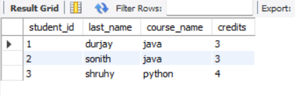
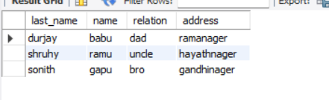
# create a data set with student id,name of student ,course with credits chose by student .
select s.student_id,s.last_name,c.course_name,c.credits from student s join course c on s.student_id=c.student_id;
Output:
# Retrive student name , parent name with relation and address.
select distinct s.last_name,p.name,p.relation,p.address from student s join parent p on s.Sur_name=p.Sur_name;
Output:

Slide 13
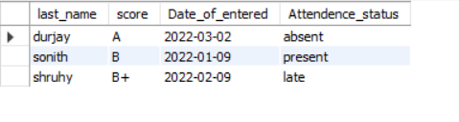
# Retrive student name ,score of academic with date of entered and attendance status
select distinct s.last_name,g.score,g.Date_of_entered,a.Attendence_status from grade g join attendence a on g.student_id=a.student_idjoin student s on g.student_id=s.student_id;
Output:

Slide 14
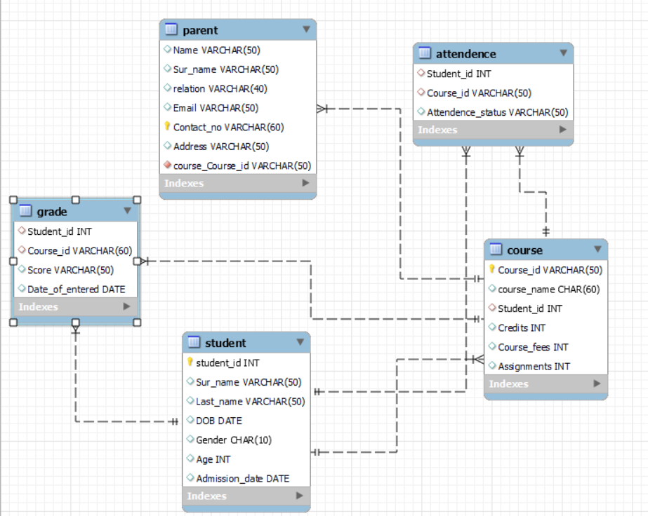
ER Diagram:

Slide 15


